Slide 1
Calculating Family Expenses Using Service Now
SlideMake.com

Slide 2

Introduction to Calculating Family Expenses
ServiceNow is a powerful platform for managing and analyzing family expenses efficiently.
It allows users to record, categorize, and track various expense types seamlessly.
Accurate expense calculation helps families plan better and make informed financial decisions.
Notes:
Image source: https://learning.servicenow.com

Slide 3
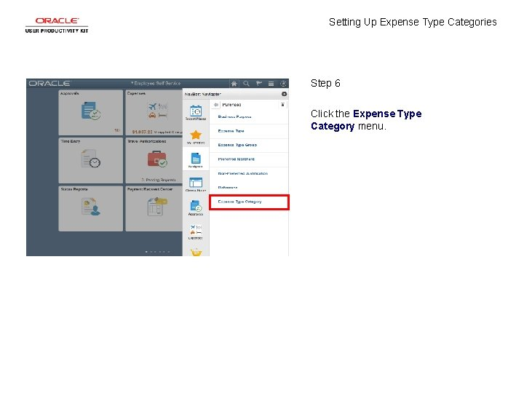
Setting Up Expense Categories in ServiceNow
Create specific categories such as Groceries, Utilities, Education, and Entertainment.
Use ServiceNow Configuration Management Database (CMDB) to organize expense data systematically.
Assign each expense to a relevant category for easier analysis and reporting.
Notes:
Image source: https://slidetodoc.com

Slide 4

Inputting Family Expenses
Users can input expenses manually through ServiceNow’s intuitive interface or import data via spreadsheets.
Include details like date, amount, category, and description for each expense entry.
Ensure data validation rules are in place to maintain accuracy and consistency.
Notes:
Image source: https://www.slidemake.com

Slide 5
Automating Expense Data Collection
Utilize ServiceNow workflows to automate recurring expense entries, such as monthly bills.
Integrate with bank accounts or financial apps through APIs to fetch transaction data automatically.
Automations reduce manual effort and minimize errors in expense tracking.
Notes:
Image source: https://www.slidemake.com

Slide 6

Calculating Total Expenses
Use ServiceNow’s reporting and scripting tools to sum expenses by category or time period.
Generate real-time dashboards to visualize total family expenses dynamically.
Set up filters to analyze specific periods, such as monthly or quarterly expenses.
Notes:
Image source: https://thumbs.dreamstime.com

Slide 7

Analyzing Expense Patterns and Trends
Leverage ServiceNow’s analytics features to identify spending habits over time.
Detect areas where expenses are increasing and assess potential savings opportunities.
Use insights to create budgets and financial goals for the family.
Notes:
Image source: https://thumbs.dreamstime.com

Slide 8
Generating Reports and Sharing Insights
Create customizable reports summarizing expenses, categories, and trends.
Share reports securely with family members or financial advisors via ServiceNow portals.
Schedule regular report generation to monitor ongoing family financial health.
Notes:
Image source: https://help.tempo.io

Slide 9

Benefits of Using ServiceNow for Family Expense Management
Streamlines expense tracking, making financial management more organized and transparent.
Provides real-time insights that aid in budget planning and cost control.
Enhances collaboration among family members for better financial decision-making.
Notes:
Image source: https://thumbs.dreamstime.com

